Slide 1

DATABASE SYSTEMS (EIE36E): SQL – Data Manipulation Language 2
Doc. Ing. Václav Vostrovský Ph.D.
Ing. Petr Hanzlík

Slide 2

Outline > DML #2
DML : SELECT
DML : SELECT + ORDER BY
DML : SELECT + DISTINCT
DML : SELECT + WHERE
DML : SELECT + GROUP BY
DML : Aggregate functions

Slide 3
SQL DML: SELECT
The SELECT statement is used to select data from a database
SQL SELECT syntax:
SELECT <column_name,…>
FROM <table_name>;

Slide 4
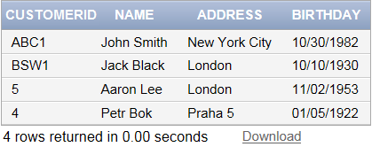
SQL DML: SELECT example
Let us add two arbitrary entities to the table. Then select all the data from the table “customers”.
INSERT INTO customers
VALUES ('BSW1','Jack Black','London','10.10.1930');
INSERT INTO customer
VALUES ('5','Aaron Lee','London','11.02.1953');
SELECT * FROM customer;

Slide 5
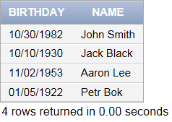
SQL DML: SELECT example
Select names and address of all the customers in the database table
SELECT birthday,name FROM customers;

Slide 6
SQL DML: SELECT + ORDER BY
The ORDER BY condition enables sorting of presented data in ascending (ASC) or descending (DESC) order. If neither is set, default is ASC
SQL SELECT syntax:
SELECT <column_name>,…
FROM <table_name>
[ORDER BY <column_name1>[ASC|DESC],
<column_name2>[ASC|DESC]];

Slide 7
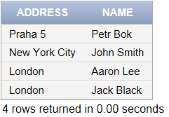
SQL DML: SELECT + ORDER BY example
Select names and address of all the customers in the database table
SELECT address,name FROM customer
ORDER BY address DESC, name ASC;

Slide 8
SQL DML: SELECT DISTINCT
The SELECT DISTINCT statement is used to return only distinct (unique) values.
SQL SELECT DISTINCT syntax:
SELECT DISTINCT <column_name>
FROM <table_name>;

Slide 9
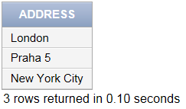
SQL DML: SELECT DISTINCT example
Generate the list of cities our customers come from
SELECT DISTINCT address FROM customers;

Slide 10
SQL DML: SELECT + WHERE
Adding WHERE to the SELECT statement returns only the subset of entities that meet the specified condition.
SQL SELECT + WHERE syntax:
Aggregate functions cannot be used in WHERE conditions!
SELECT <column_name> FROM <table_name>
WHERE <logical_condition>;

Slide 11
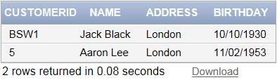
SQL DML: SELECT + WHERE example
Select all the customers coming from London.
SELECT * FROM customers
WHERE address='London';

Slide 12
SQL DML: SELECT + WHERE + AND & OR
Compound conditions are made up of multiple simple conditions connected by AND or OR.
SQL SELECT + WHERE + AND/OR syntax:
AND = Both conditions must be fulfilled
OR = At least one of the conditions must be met
SELECT <column_name> FROM <table_name>
WHERE <logical_condition>[AND|OR]<logical_condition>;

Slide 13

SQL DML: SELECT WHERE + AND example
Select all the customers coming from London born after 1945.
SELECT * FROM customers
WHERE address='London' AND birthday> '1.1.1945';

Slide 14
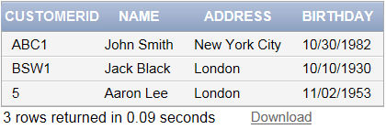
SQL DML: SELECT WHERE + OR example
Select all the customers living in London and NY
SELECT * FROM customers
WHERE address='London' OR address='New York City';

Slide 15
SQL DML: SELECT + aggregated functions
SQL offers many built-in functions for performing calculations on selected data.
These functions include:
COUNT - returns the number of rows
SUM - returns the sum
AVG - returns the average value
MIN - returns the smallest value
MAX - returns the largest value

Slide 16
SQL DML: SELECT + aggregated functions
Adding WHERE to the SELECT statement returns only the subset of entities that meet the specified condition
SQL SELECT + aggregated function syntax:
SELECT function(<column_name>) FROM <table_name>
WHERE <logical_condition>;

Slide 17


SQL DML: SELECT + function example
Select birth date of the youngest customer
Select the youngest customer from the customer table
SELECT MAX(birthday) FROM customers;
SELECT * FROM customers
WHERE birthday = (SELECT MAX(birthday) FROM customer);

Slide 18
SQL DML: function + GROUP BY
The GROUP BY statement can be used in conjunction with aggregate function COUNT to group the result-set by one or more columns.
SQL SELECT + COUNT + GROUP BY syntax:
SELECT<column_name>, COUNT(<collumn_name>)
FROM <table_name> GROUP BY <column_name1>;

Slide 19
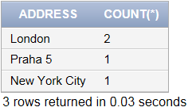
SQL DML: function + GROUP BY example
Count the customer base in individual cities
SELECT address,COUNT(*) FROM customers
GROUP BY address;

